Slide 1
Windows Azure … everything you wanted to know (or should)
Scott Decker
Robert Greiner
Craig Smitham
Nick Stephens

Slide 2
What we’ll be talking about
Azure in Context: The History and Promise of the Cloud
Azure Services, Ecosystem, and Tools
The Demands of Distribution

Slide 3
How We Got Here
Cloud computing was envisioned as early as the 1960s
Computing as a service, much like a utility, has been seen as the next big step in the evolution of industry
Amazon Web Services 2006
Windows Azure CTP 2008
Windows Azure RTM February 2010

Slide 4
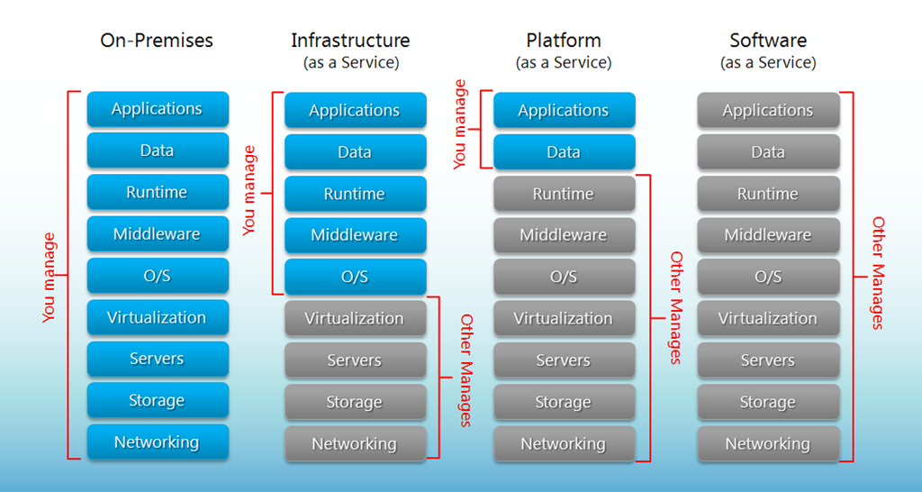
Compute Delivery Models
Source: http://www.brightpattern.com/2013/clearest-explanation-yet-of-saas-paas-iaas/

Slide 5
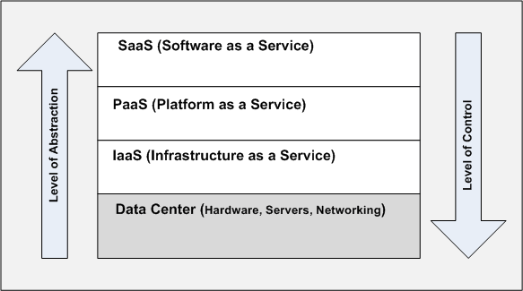
… another Perspective
Source: http://blogs.msdn.com/b/jmeier/

Slide 6

Some Examples
On Premise: Your laptop, Dedicated Servers
IaaS: VPS Providers, Amazon EC2, Azure VMs
PaaS: Azure Cloud Services, Amazon Elastic Beanstalk, Heroku, nodejitsu
SaaS: Office 365, Mint.com, Spotify, Salesforce

Slide 7
Azure At-A-Glance
Applications: Blogs, Ecommerce, Forums, Wiki
Data: SQL, NoSQL Table Storage, 3rd Party (MongoDb, etc)
Runtime: .NET, Java, Node.js, Python, PHP, Ruby … and more
Middleware: Azure Service Bus, BizTalk Services, 3rd Party App Services
O/S: Windows, Linux
Virtualization/Servers: XS shared core 768MB to 8 core 56GB
Storage: Binary Blob Storage
Networking: Traffic Manager, VPN

Slide 8
Azure At-A-Glance
Applications: Blogs, Ecommerce, Forums, Wiki
Data: SQL, NoSQL Table Storage, 3rd Party (MongoDb, etc)
Runtime: .NET, Java, Node.js, Python, PHP, Ruby … and more
Middleware: Azure Service Bus, BizTalk Services, 3rd Party App Services
O/S: Windows, Linux
Virtualization/Servers: XS shared core 768MB to 8 core 56GB
Storage: Binary Blob Storage
Networking: Traffic Manager, VPN

Slide 9
Azure At-A-Glance
Applications: Blogs, Ecommerce, Forums, Wiki
Data: SQL, NoSQL Table Storage, 3rd Party (MongoDb, etc)
Runtime: .NET, Java, Node.js, Python, PHP, Ruby … and more
Middleware: Azure Service Bus, BizTalk Services, 3rd Party App Services
O/S: Windows, Linux
Virtualization/Servers: XS shared core 768MB to 8 core 56GB
Storage: Binary Blob Storage
Networking: Traffic Manager, VPN

Slide 10
Cloud Services
Nick Stephens

Slide 11
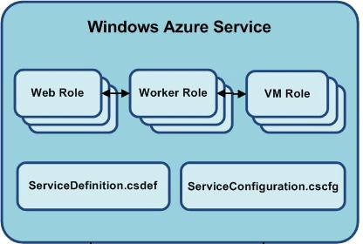

Cloud Services
Cloud Services are deployments to Azure PaaS
Code
Configuration
Notes:
Slide Objectives:
Define cloud service
VALUE PROP:
Speaking Points:
Cloud services are the code and configuration deployed to Azure PaaS
Notes:

Slide 12
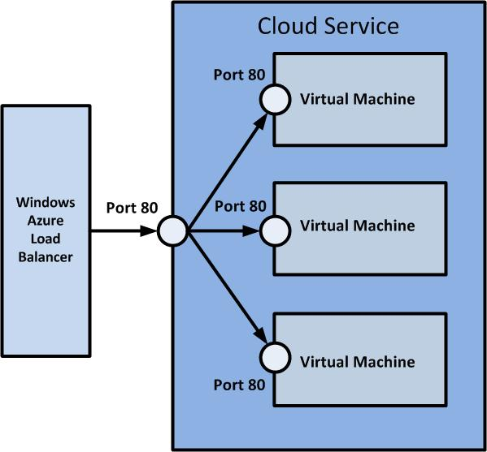
Cloud Services - Code
Two types of Roles
Web Role
Worker Role
Web Role
IIS Web Server
Host Web Front End or API layer
Public endpoints are load balanced
Notes:
Slide Objectives:
Define roles and general uses
VALUE PROP:
Speaking Points:
Web roles are windows servers with IIS installed. Used for Web or API layer.
Load balanced by Azure. Round Robin.
Notes:

Slide 13
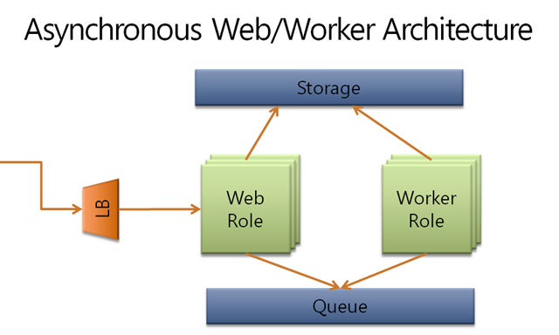
Cloud Services - Code
Worker Roles
“Console App” that infinitely processes tasks
Usually setup to read from queue
Host asynchronous “Deferred Processor”
Notes:
Slide Objectives:
Define roles and general uses
VALUE PROP:
Speaking Points:
Worker roles are windows servers without IIS.
Essentially a console app that infinitely reads from queue.
Coined the term Deferred Processor
Notes:

Slide 14
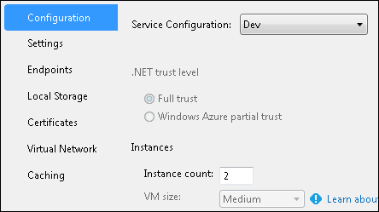
Cloud Services - Configuration
Defines settings for Cloud Service
Type, size, and instance count of roles
Ex, 1 Medium Web Role and 2 Small Worker Roles
Endpoints of application
HTTP, HTTPS, TCP, etc.
Certificates
SSL, etc.
In-Role Caching
Cache shared within Cloud Service
Notes:
Slide Objectives:
Explain what configuration defines and what can vary between environments
VALUE PROP:
Speaking Points:
Configuration defines roles, endpoints, certs, caching, etc. Instance count, cert thumbprints, cache settings can be changed.
Most are configured per role, but instances and cache settings can vary between environments
Notes:

Slide 15
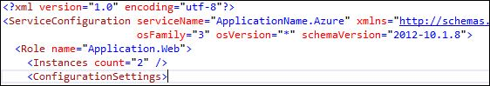
Cloud Services - Configuration
Also defines version of Windows Server to run
OS Family
1 - Windows Server 2008 SP2, .NET 3.5/4.0 only
2 - Windows Server 2008 R2, .NET 3.5/4.0
3 - Windows Server 2012, .NET 4.0/4.5
OS Version
MSRC Patch number, ex 2.11
Defaults to “*”, automatic application of patches
Leave on default unless you need specific family/version
Notes:
Slide Objectives:
Define version of deployed server and options
VALUE PROP:
Speaking Points:
Can specify what OS and version to use. Several options but leave at default to get updates automatically.
Notes:

Slide 16
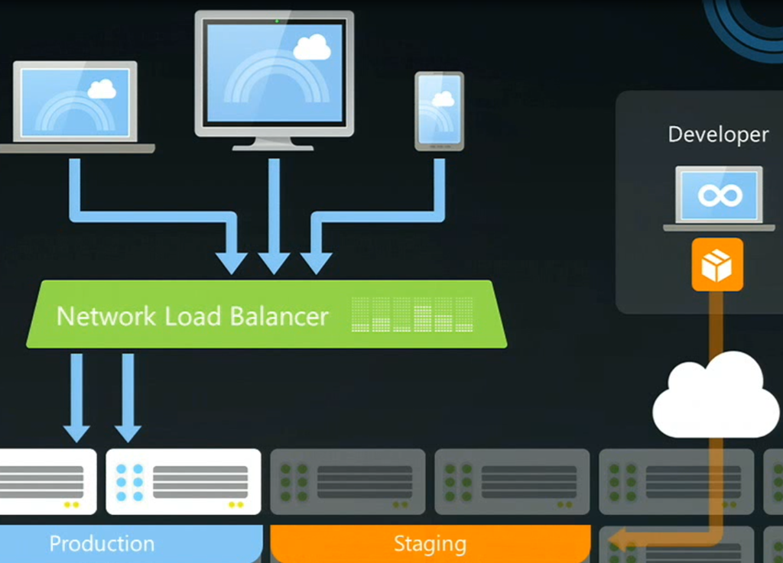
Cloud Services - Concepts
Staging vs Production Slot
Deploy to Staging and then Swap VIP
Notes:
Slide Objectives:
Explain staging vs production slot and uses
VALUE PROP: Staging makes deployments easier and can rollback
Speaking Points:
Each cloud service has two slots. One has friendly name the other has unique name, guid.
Each slot contains a deployment of the cloud service, code, configs and all.
Staging was designed to be deployed to, verify configs, and smoke test with unique URL if possible.
To deploy, swap virtual ip so staging slot becomes production and production become staging.
To rollback, swap back to original setup.
Still charged for deployments in staging slot, running or not.
Notes:

Slide 17
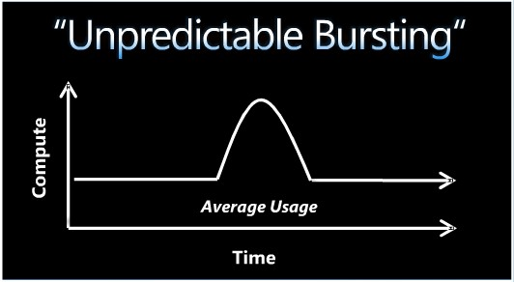
Cloud Services - Features
Auto Scaling
Built to handle varying system load
Can increase or decrease instances within threshold
Each role can scale independently
Notes:
Slide Objectives:
Describe auto scaling and when to use each method
VALUE PROP:
Speaking Points:
Auto scaling was designed to handle non-uniform load to the system. Can’t compensate for short bursts but handles gradual increased load.
Autoscaling will add or remove instances as defined. It takes 5-10min for instances to be provisioned and started.
Default scaling metrics are avg CPU, avg queue length, or at specified times.
Each role can scale independently up to subscription limit
Web roles usually scale by CPU or time, worker roles usually scale by queue length or time.
Notes:

Slide 18
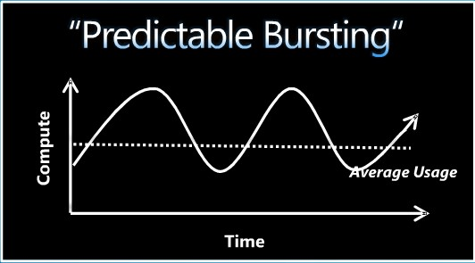
Cloud Services - Features
Auto Scaling
Scale by CPU %
Good for Web Roles because
Increased CPU can mean increase wait time for users
Scale by Queue Length
Good for Worker Roles
Long queue means more work to process
Scale on Schedule
Good for predictable load
Notes:
Slide Objectives:
Describe auto scaling and when to use each method
VALUE PROP:
Speaking Points:
Auto scaling was designed to handle non-uniform load to the system. Can’t compensate for short bursts but handles gradual increased load.
Autoscaling will add or remove instances as defined. It takes 5-10min for instances to be provisioned and started.
Default scaling metrics are avg CPU, avg queue length, or at specified times.
Each role can scale independently up to subscription limit
Web roles usually scale by CPU or time, worker roles usually scale by queue length or time.
Notes:

Slide 19
Cloud Services - Features
Diagnostics
Help monitor and troubleshoot application
Can define performance counter to record
CPU, Memory, Caching, Custom, etc.
Log messages in application
Use Trace logging with severity
Use TraceSwitch to filter what severities gets logged
Writes out to configurable Table Storage account
WADLogsTable for logs
WADPerformanceCountersTable for performance counters
Notes:
Slide Objectives:
Define diagnostics features
VALUE PROP:
Speaking Points:
Diagnostics helps monitor and troubleshoot application.
Performance counters capture system information.
Logging captures application events and messages.
Can filter on severity so only warnings or higher get logged
Configure storage account to persist logs and counters
Notes:

Slide 20
Cloud Services – Best Practices
Segment large applications into multiple Cloud Services
Web Cloud Service and API/Backend Cloud Service
Separation of concerns
Deploy to staging and swap
More testable and have rollback strategy
Design application to scale out not up
Easier to add instances than to increase hardware
Notes:
Slide Objectives:
Explain common best practices
VALUE PROP:
Speaking Points:
Split application into multiple cloud services.
Deploy to staging and swap. Allows verification and rollback path.
Scale out not up. Split work to be handled my many instances rather than one.
Notes:

Slide 21
Questions

Slide 22
Virtual Machines
Nick Stephens

Slide 23
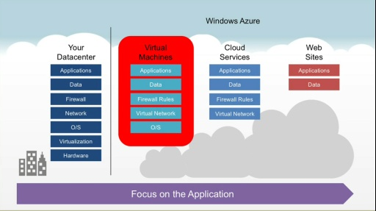
Virtual Machines
IaaS
Deploy VM images to hardware in Azure datacenter
More control than Cloud Service
Can provision new hardware as needed
Notes:
Slide Objectives:
Define Azure Virtual Machines
VALUE PROP:
Speaking Points:
VMs are IaaS. Microsoft provides infrastructure, you provide the rest.
Easily scale to need.
Notes:

Slide 24
Virtual Machines
Deploy to Cloud or On-Premise, or both
VM is portable
Can choose from Azure VM Gallery
SQL Server, SharePoint, Linux, etc.
License included in pricing
Connect to On-Premise network via Site-to-Site VPN
Treat Azure VMs just like On-Premise servers
Configure load balancing for multiple VMs
Notes:
Slide Objectives:
Features of Azure VMs
VALUE PROP:
Speaking Points:
Can deploy to Azure, On-Premise, or Both. Deploying just a VM image, so it is portable.
Microsoft provides a gallery of images you can choose from like SQL Server, SharePoint, Linux Servers and more.
License is included in pricing.
Can connect cloud to on-premise via Site-to-Site VPN.
VMs can be load balanced
Notes:

Slide 25
Azure Web Sites
Craig Smitham

Slide 26
Azure Web Sites
Built on top of cloud services. PaaS made easy.
Deploy multiple websites to a single cloud service.
Simple setup and configuration.
No special SDK/project type required.
Out of the box support for .NET, node.js, PHP and python
One click auto scaling
Simple diagnostic setup
Notes:
Slide Objectives:
Features of Azure VMs
VALUE PROP:
Speaking Points:
Can deploy to Azure, On-Premise, or Both. Deploying just a VM image, so it is portable.
Microsoft provides a gallery of images you can choose from like SQL Server, SharePoint, Linux Servers and more.
License is included in pricing.
Can connect cloud to on-premise via Site-to-Site VPN.
VMs can be load balanced
Notes:

Slide 27
Azure Web Sites - Modes
Three modes to choose from
Free
Shared
Standard (Reserved virtualized instance)
Notes:
Slide Objectives:
Features of Azure VMs
VALUE PROP:
Speaking Points:
Can deploy to Azure, On-Premise, or Both. Deploying just a VM image, so it is portable.
Microsoft provides a gallery of images you can choose from like SQL Server, SharePoint, Linux Servers and more.
License is included in pricing.
Can connect cloud to on-premise via Site-to-Site VPN.
VMs can be load balanced
Notes:

Slide 28
Azure Web Sites - Pricing
 | FREE | SHARED (PREVIEW) | STANDARD
CPU | Shared¹ | Shared¹ | Dedicated
Custom domain support | Not Available | Available | Available
Custom domain SSL | Not Available | Not Available | See SSL pricing
Scale-out | Not Available | Up to 6 instances | Up to 10 instances
Sites² | 10 | 100 | 500
Storage² | 1 GB | 1 GB | 10 GB
Relational database³ (optional) | 20 MB included, Standard rates apply for additional capacity | 20 MB included, Standard rates apply for additional capacity | 20 MB included, Standard rates apply for additional capacity
Outbound data transfer ² | Up to 165MB per day | Standard rates apply | Standard rates apply
Notes:
Slide Objectives:
Features of Azure VMs
VALUE PROP:
Speaking Points:
Can deploy to Azure, On-Premise, or Both. Deploying just a VM image, so it is portable.
Microsoft provides a gallery of images you can choose from like SQL Server, SharePoint, Linux Servers and more.
License is included in pricing.
Can connect cloud to on-premise via Site-to-Site VPN.
VMs can be load balanced
Notes:

Slide 29
Azure Mobile Services
Craig Smitham

Slide 30
Azure Mobile Services
Another PaaS made easy.
Backend as a service a la Parse, Appcelerator, Kinvey
Provides basic NoSQL-esqe data storage
Schemaless
Powered by SQL
Instant REST API for data
Custom API endpoints
Powered by node.js!
Recurring jobs
Access to Azure APIs within runtime
Notes:
Slide Objectives:
Features of Azure VMs
VALUE PROP:
Speaking Points:
Can deploy to Azure, On-Premise, or Both. Deploying just a VM image, so it is portable.
Microsoft provides a gallery of images you can choose from like SQL Server, SharePoint, Linux Servers and more.
License is included in pricing.
Can connect cloud to on-premise via Site-to-Site VPN.
VMs can be load balanced
Notes:

Slide 31
Azure Mobile Services
Use Cases
Mobile
Desktop apps
Service Façade
 | FREE¹ | STANDARD | PREMIUM
Price² | Free (up to 10 services / month) | $25 / month per unit | $199 / month per unit
API Calls² | 500K | 1.5M per unit | 15M per unit
Active Devices³ | 500 | Unlimited | Unlimited
Scale | N/A | Up to 6 units | Up to 10 units
Scheduled jobs⁴ | Limited | Included | Included
SQL Database⁵ (required) | 20 MB included, Standard rates apply for additional capacity | 20 MB included, Standard rates apply for additional capacity | 20 MB included, Standard rates apply for additional capacity
Notes:
Slide Objectives:
Features of Azure VMs
VALUE PROP:
Speaking Points:
Can deploy to Azure, On-Premise, or Both. Deploying just a VM image, so it is portable.
Microsoft provides a gallery of images you can choose from like SQL Server, SharePoint, Linux Servers and more.
License is included in pricing.
Can connect cloud to on-premise via Site-to-Site VPN.
VMs can be load balanced
Notes:

Slide 32
Access Control Service
Scott Decker

Slide 33

How do I authenticate users in Azure?
Website
ACS
Notes:
Slide Objectives
Introduce ACS
VALUE PROP
ACS is a way to outsource authenticating users in your system
Speaker Notes
Notes

Slide 34
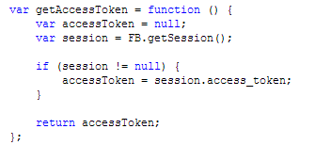
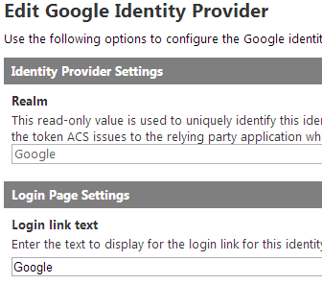
How is Azure ACS different?
Old Way
New Way
You don’t have to write the code!
Notes:
Slide Objectives
Contrast old and new way
VALUE PROP
Rather than storing usernames and passwords, users can authenticate thru accounts they already have
Speaker Notes
People don’t want more usernames and passwords to remember
People don’t trust you with usernames and passwords
People want fast
You can use ADFS (Active Directory Federation Services) as well
Notes
Supported protocols: Open Authorization (OAuth), OpenID, WS-Federation, WS-Trust
Supported tokens: JSON Web Token (JWT), SAML 1.1, SAML 2.0, and Simple Web Token (SWT)

Slide 35
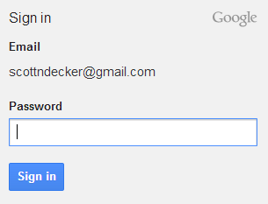
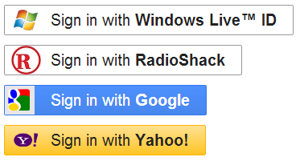

ACS authentication for low D people
I want to log in via Google (3)*
This is who this person is (5)
ACS
This person is in the following roles on the site (7)
*() refer to steps in previous slide
Notes:
Slide Objectives
Explain it in high level terms
VALUE PROP
ACS adds value to your website by not having to worry about handling the authentication
Speaker Notes
Notes

Slide 36
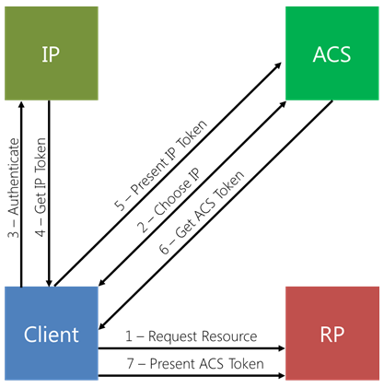
ACS authentication for high D people
Identity Provider
ACS
Client
Relying Party App
http://www.windowsazure.com/en-us/develop/net/how-to-guides/access-control/
http://msdn.microsoft.com/en-us/library/hh446535.aspx
Notes:
Slide Objectives
Explain in detail how ACS works as a middle man to authenticate
VALUE PROP
By using ACS, we don’t have to have any of the code to check usernames and passwords or map claims to roles. All that happens in ACS.
Speaker Notes
Claims are added to the token and returned from the Identity Provider
ACS can take the claims and map them to roles
Notes

Slide 37
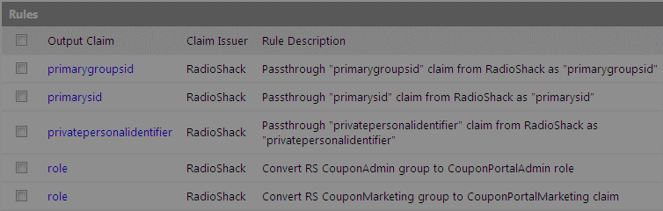
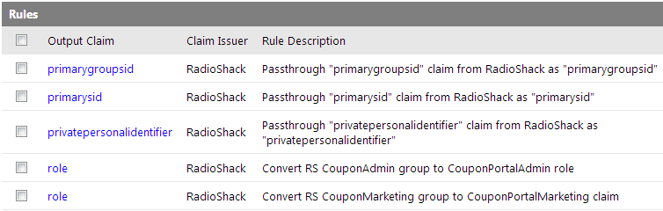
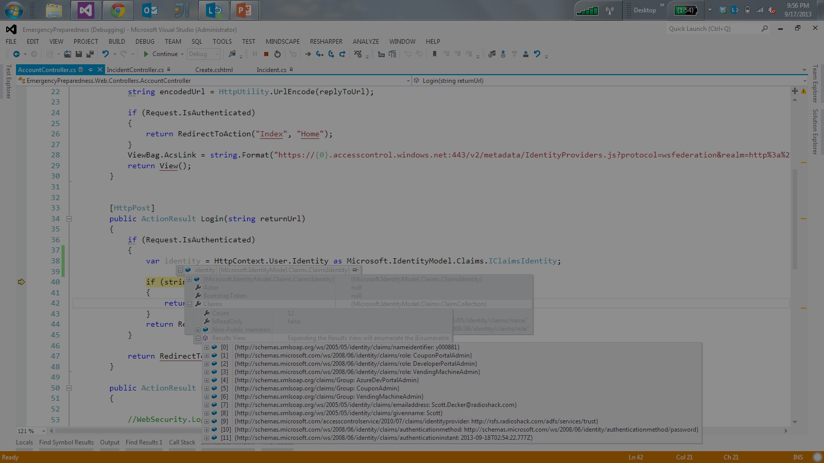
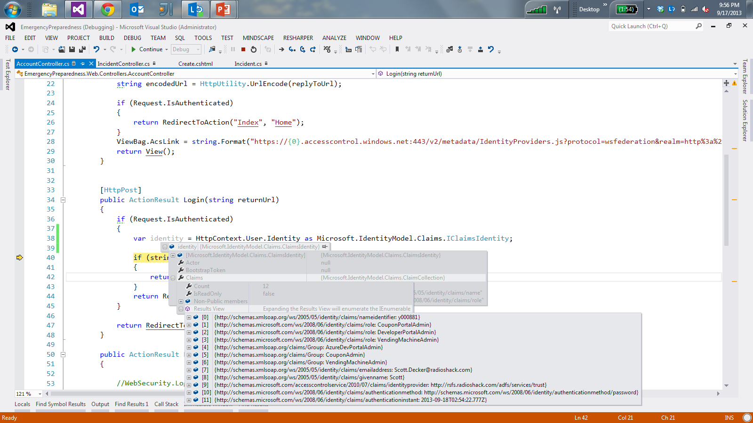
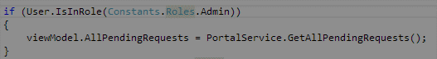
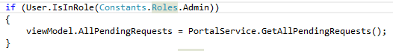
What are claims and roles?
Notes:
Slide Objectives
Explain claims and roles
VALUE PROP
ACS can transform claims passed from the Identity Provider into roles
Speaker Notes
An identity provider passes back the token with associated claims
ACS can map a claim like “Group” to a claim called “role”
The role can then be used to allow for permissions over certain controller actions
Notes

Slide 38
Azure Service Bus
Slides: Service Bus Messaging Deep Dive http://channel9.msdn.com/Blogs/Subscribe/Service-Bus-Messaging-Deep-Dive

Slide 39
What is Service Bus?
Cloud-Hosted or Self-Hosted Messaging Middleware
Windows Azure Service Bus
All Windows Azure Datacenters + Select Customer Appliances
Multiple Clusters (Scale-Units) per Datacenter
Service Bus for Windows Server 1.0
Downloadable component for Windows Server (and Windows client for Dev)
Runs on top of SQL Server Express (up to SQL 2012 Always-On Cluster)
Messaging largely symmetric with cloud version, but lags up to 12 months behind
Key Features:
Pub/Sub Reliable Messaging, Relay*, Notifications**
*cloud-only for now
**cloud-only for the forseeable future

Slide 40
Service Bus Brokered Messaging
Queues
Topics
Ordered Message Log
Ordered by arrival (broker assigns strongly monotonic sequence number to each msg)
Timestamped on arrival (authoritative clock)
Stored in SQL; once accepted, the message is as safe as any data in the SQL deployment
Multiplexing with sessions
Two modes: Pull and Forward
Pull – delivers messages on request, allowing concurrent readers
Forward – delivers message to single forward destination
All features of Queues, plus
Multiple, Independent Subscriptions
Named, durably created (optional)
Quota: Up to 2000 concurrent subscriptions
Reco is to start partitioning much, much earlier (more later)
Rules with filter conditions on msg headers
Quota: Up to 2000 rules per subscription
Optional action set/modify message props
Each rule hit yields a message
Topic 'tail' and subscription 'head' are fully protocol compatible with Queues

Slide 41
Programming Model Options
Apps
Windows
Whatever
.NET Service Bus Messaging API
Java/JMS
Apache Qpid JMS AMQP 1.0
.NET WCF Service Model
C/C++ (incl Embedded)
Apache Proton-C
Python client
PHP client
Node.js client
Any HTTP client
NetMessagingBinding
SB Messaging Protocol (net.tcp, proprietary)
AMQP 1.0
HTTP(S)
Service Bus

Slide 42
Connectivity Options
AMQP 1.0
OASIS standard, growing base of clients across many platforms
AMQPS TCP 5671, AMQP TCP 5672
Preview status, general availability later this year
"SBMP" Service Bus Messaging Protocol
Only supported by .NET client, Microsoft proprietary, based on WCF's NetTcp
TCP port 9354 or HTTP tunneling over port 443 or port 80
HTTPS
TCP 443
RFC2616 – majority of Service Bus features available for any HTTPS client

Slide 43
Message Model
Service Bus Message
Sys Properties
Key
Value
Brokered messaging properties are not SOAP headers
System properties have special meaning to the broker or or set by the broker
Properties are key/value pairs that may very well carry payloads
It's not uncommon to have messages with empty message bodies
Message bodies are useful for a single opaque payload not exposed to the broker (e.g. encrypted content)
Key
Value
Key
Value
Custom Properties
Key
Value
Key
Value
Key
Value
Key
Value
Body
Body (Bag of Bytes)

Slide 44
Message Dimensions
Service Bus Message
Sys Properties
Max Message: 256 Kbyte
Max Total Props: 64 Kbyte
Includes sys props, reserve ~4 KByte
Max Prop: No explicit limit
Constrained by de-facto HTTP limits if you use HTTP; ~4KB for a header max
Max Body: 256KByte – sizeof(Props)
Yes, yes. Just wait. We'll get to how you can send payloads exceeding 256 KByte …
Key
Value
Key
Value
Key
Value
Custom Properties
64KB max
Key
Value
256 KB max
Key
Value
Key
Value
Key
Value
Body
Body (Bag of Bytes)

Slide 45
Message Protocol Mapping: HTTP
HTTP Message
Service Bus Message
BrokerProperties
Sys Properties
Headers
Key
Value
BrokerProperties
{ json }
Key
Value
Hdr
Value
Key
Value
Hdr
Value
Custom Properties
Hdr
Value
Key
Value
Key
Value
Hdr
Value
Key
Value
Key
Value
Entity Body
Body
Entity
Body (Bag of Bytes)

Slide 46
Brokered Transfer
S
R
Queue
Load Leveling
Receiver receives and processes at its own pace. Can never be overloaded. Can add receivers as queue length grows, reduce receiver if queue length is low or zero. Gracefully handles traffic spikes by never stressing out the backend.
Offline/Batch
Allows taking the receiver offline for servicing or other reasons. Requests are buffered up until the receiver is available again.

Slide 47
Competing Consumer
R
S
R
Queue
R
Load Balancing
Multiple receivers compete for messages on the same queue (or subscription). Provides automatic load balancing of work to receivers volunteering for jobs.
Observing the queue length allows to determine whether more receivers are required.

Slide 48
Fan-In
S
S
R
Queue
S
Concentrator
Fan information into a single queue from a range of data sources
Multi-Stage Aggregration / Rollup
Fan into a set of queues, perform aggregation/roll-up/reduction and fan further.

Slide 49
Taps and Fan-Out
R
S
Sub
R
Topic
Sub
Sub
R
Message Distribution
Each receiver gets its own copy of each message. Subscriptions are independent. Allows for many independent 'taps' into a message stream. Subscriber can filter down by interest.
Constrained Message Distribution (Partitioning)
Receiver get mutually exclusive slices of the message stream by creating appropriate filter expressions.

Slide 50
Filtering
R
S
Sub
R
Topic
Sub
Sub
R
Name LIKE 'V%'
Up to 2000 rules per subscription
Each matched rule yields a message copy
SQL'92 expressions over message properties

Slide 51
Partitioning
PartId > 0 AND PartId <= 272
R
S
PartId > 272 AND PartId <= 567
Sub
R
Topic
Sub
Sub
PartId > 567 AND PartId <= 791
R
Rule conditions form mutually exclusive ranges
Allows partitioning-aware message distribution
No need for sender to be aware of partitioning

Slide 52
Storage
Robert Greiner

Slide 53

Let’s talk about how data works in Azure

Slide 54

How does data work in Windows Azure?

Slide 55



Azure Data Management
Azure Tables
Azure Blobs
Azure Queues
Azure SQL Database
Notes:
Slide Objectives:
Highlight the four areas in which this session will focus on.
VALUE PROP:
Speaking Points:
This session will cover the following topics:
SQL Server in a Virtual Machine
Windows Azure SQL Database
Azure Table Storage
Azure Blob Storage
Notes:

Slide 56
Azure Table Storage
NoSQL Data Storage
Fully managed PaaS
Key-value
Hierarchical
REST API
Geo replication
Account
Storage Account: MovieData
Table Name: Movies
Star Wars
Matrix
Fan Boys
Table
Entity
Notes:
Slide Objectives:
Define the table storage and differentiate it from a Windows Azure SQL Database
VALUE PROP
Highly scalable NoSQL Data storage
Speaking Points:
Tables offer NoSQL capabilities for applications that require storage of large amounts of unstructured data. Tables are an ISO 27001 certified managed service which can auto scale to meet massive volume of up to 100 terabytes and throughput and accessible from virtually anywhere via REST and managed API’s.
Tables store entities
Entity schema can vary in the same table
Hierarchial
Automatic scalability
New Geo Replication
Notes:

Slide 57
Table Storage Concepts
Account
Table
Entity
Name =…
Email = …
customers
Name =…
EMailAdd=
contoso
Photo ID =…
Date =…
photos
Photo ID =…
Date =…
Notes:
Slide Objectives
Understand Tables
VALUE PROP
Enable customers to easily migrate, maintain, and monitor their existing SQL Server applications to Windows Azure VM role, and run them with competitive reliability, performance, and TCO characteristics.
Speaker Notes
The Table service provides structured storage in the form of tables.
The Table service supports a REST API that is compliant with the ADO.NET Data Services REST API.
Developers may also use the .NET Client Library for ADO.NET Data Services to access the Table service.
Notes
Within a storage account, a developer may create named tables. Tables store data as entities. An entity is a collection of named properties and their values, similar to a row. Tables are partitioned to support load balancing across storage nodes. Each table has as its first property a partition key that specifies the partition an entity belongs to. The second property is a row key that identifies an entity within a given partition. The combination of the partition key and the row key forms a primary key that identifies each entity uniquely within the table.

Slide 58

Table Details
Create, Query, Delete
Tables can have metadata
Not an RDBMS! Table
Insert
Update
Merge – Partial update
Replace – Update entire entity
Upsert
Delete
Query
Entity Group Transactions
Multiple CUD Operations in a single atomic transaction
Entities
Notes:
Slide Objectives
Understand Tables
Speaker Notes
Within a storage account, a developer may create named tables.
Tables store data as entities.
An entity is a collection of named properties and their values, similar to a row.
Tables are partitioned to support load balancing across storage nodes.
Each table has as its first property a partition key that specifies the partition an entity belongs to.
The second property is a row key that identifies an entity within a given partition.
The combination of the partition key and the row key forms a primary key that identifies each entity uniquely within the table.
The Table service does not enforce any schema.
A developer may choose to implement and enforce a schema on the client side
Notes
http://msdn.microsoft.com/en-us/library/dd573356.aspx

Slide 59
No Fixed Schema
 | FIRST | LAST | BIRTHDATE
 | Wade | Wegner | 2/2/1981
 | Nathan | Totten | 3/15/1965
 | Nick | Harris | May 1, 1976
FAV SPORT
Canoeing
Notes:
Slide Objectives
Understand Flexible Entities
VALUE PROP
Enable customers to easily migrate, maintain, and monitor their existing SQL Server applications to Windows Azure VM role, and run them with competitive reliability, performance, and TCO characteristics.
Speaker Notes
Tables store data as entities.
A table can contain entities of any shape
There is no fixed schema
There is no schema checking
There is no strong typing- not that Birthdate is stored as both a datetime value and as a string
Not that we can add additional columns
Notes
http://msdn.microsoft.com/en-us/library/dd573356.aspx

Slide 60
Purpose of the PartitionKey
Entity Locality
Entities in the same partition will be stored together
Efficient querying and cache locality
Endeavour to include partition key in all queries
Entity Group Transactions
Atomic multiple Insert/Update/Delete in same partition in a single transaction
Table Scalability
Target throughput – 500 tps/partition, several thousand tps/account
Windows Azure monitors the usage patterns of partitions
Automatically load balance partitions
Each partition can be served by a different storage node
Scale to meet the traffic needs of your table
Notes:
Slide Objectives
Understand The Partition Key
Speaker Notes
Tables are partitioned to support load balancing across storage nodes.
A table's entities are organized by partition.
A partition is a consecutive range of entities possessing the same partition key value.
The partition key is a unique identifier for the partition within a given table, specified by the PartitionKey property.
The partition key forms the first part of an entity's unique identifier within the table.
The partition key may be a string value up to 1 KB in size.
You must include the PartitionKey property in every insert, update, and delete operation.
Notes
http://msdn.microsoft.com/en-us/library/dd573356.aspx
http://blogs.msdn.com/b/windowsazurestorage/archive/2010/05/07/understanding-the-scalability-availability-durability-and-billing-of-windows-azure-storage.aspx
http://blogs.msdn.com/b/windowsazurestorage/archive/2010/05/10/windows-azure-storage-abstractions-and-their-scalability-targets.aspx

Slide 61
Scalability
PartitionKey
Unique identifier for the partition within a give table.
RowKey
Unique Identifier for an entity within a given partition.
Both Keys matter!
Define Primary Key
Forms a single clustered index
Very Fast
Partition Key + Row Key
Slower
Only Partition Key
No Row Key
Slowest
No Partition Key
No Row Key
Notes:
Slide Objectives
Understand the importance of Windows Azure Table scalability model and how Partition Key and Row Key are critical for table scalability
VALUE PROP
Enable customers to easily migrate, maintain, and monitor their existing SQL Server applications to Windows Azure VM role, and run them with competitive reliability, performance, and TCO characteristics.
Speaker Notes
Table entities represent the units of data stored in a table and are similar to rows in a typical relational database table. Each entity defines a collection of properties. Each property is key/value pair defined by its name, value, and the value's data type. Entities must define the following three system properties as part of the property collection:
PartitionKey – The PartitionKey property stores string values that identify the partition that an entity belongs to. This means that entities with the same PartitionKey values belong in the same partition. Partitions, as discussed later, are integral to the scalability of the table.
RowKey – The RowKey property stores string values that uniquely identify entities within each partition.
Notes
Tables are partitioned to support load balancing across storage nodes. A table's entities are organized by partition. A partition is a consecutive range of entities possessing the same partition key value. The partition key is a unique identifier for the partition within a given table, specified by the PartitionKey property. The partition key forms the first part of an entity's primary key. The partition key may be a string value up to 1 KB in size.

Slide 62
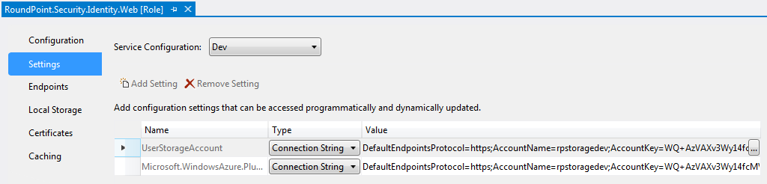
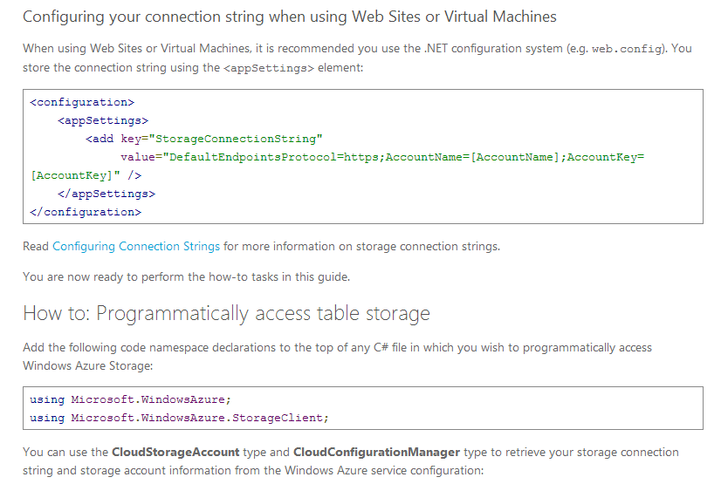
Accessing Table Storage
Storage is accessed through a connection string using the Account Name and Account Key
The connection string is saves in the cloud settings for each role

Slide 63
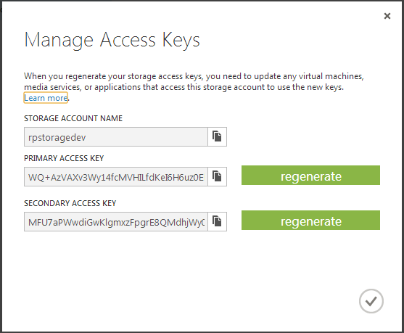
Why are there two keys?
Two keys allows you to regenerate one key while using the other for added security.
Always use the Primary Key
Before generating a new Primary Key, update all roles to use the secondary key, update the primary key, then set all the roles back to the Primary Key

Slide 64
Accessing Table Storage (Cont.)
3 libraries exist for accessing Azure Table Storage
Microsoft’s Windows Azure Storage Client
Lokad
CloudFx

Slide 65
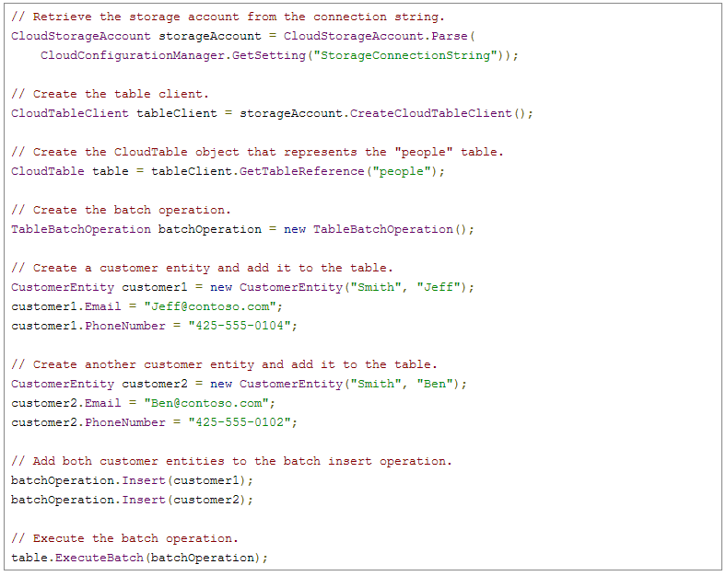
Querying Table Storage v2.0 - Insert
http://www.windowsazure.com/en-us/develop/net/how-to-guides/table-services/

Slide 66
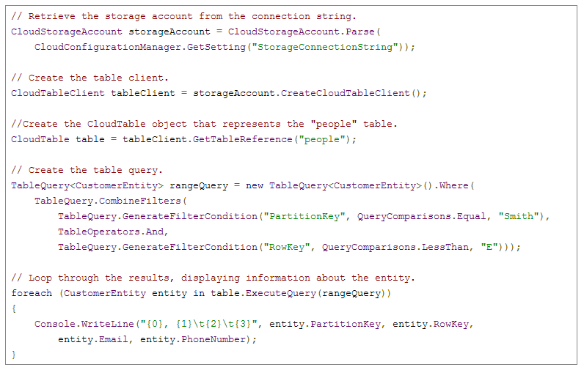
Querying Table Storage v2.0 - Query
Query on PK, RK, and even table properties using the TableQuery class
http://www.windowsazure.com/en-us/develop/net/how-to-guides/table-services/

Slide 67
Table Limitations
Rows are limited to 1mb
Properties are limited to 64kb
Up to 255 properties (including PK, RK, Timestamp)
Only 1000 records can be retrieved per call
Up to 20,000 per second can be processed
http://msdn.microsoft.com/en-us/library/windowsazure/dd179338.aspx
http://blogs.msdn.com/b/windowsazure/archive/2012/11/02/windows-azure-s-flat-network-storage-and-2012-scalability-targets.aspx

Slide 68
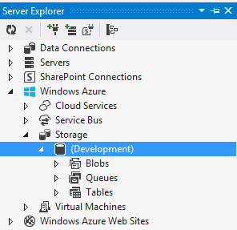
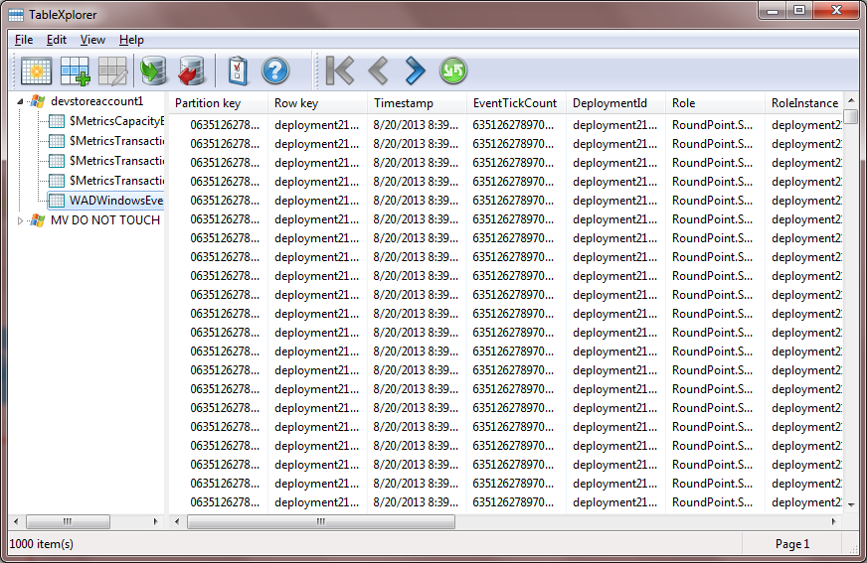
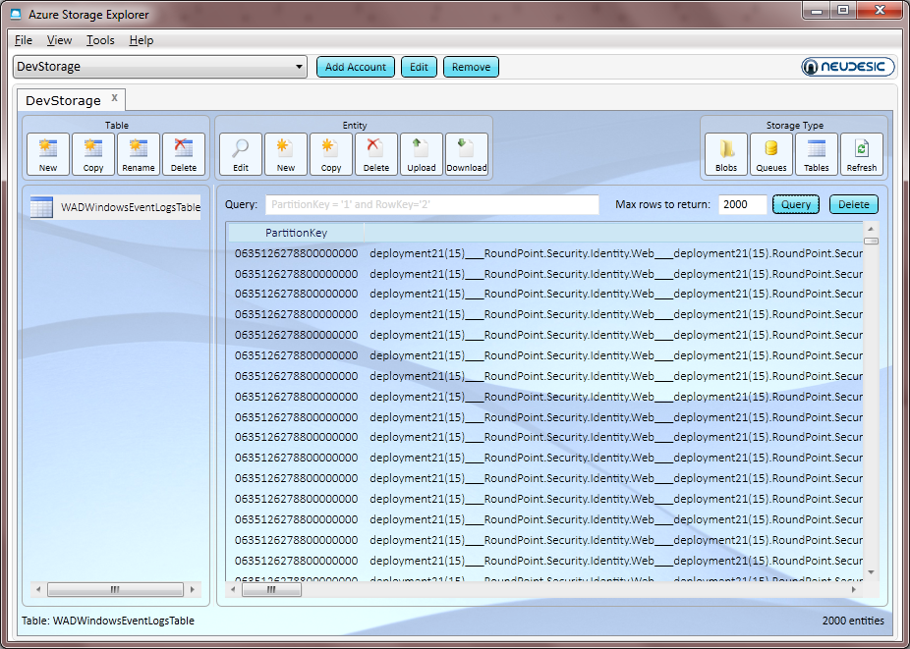
Tools
Visual Studio
Query/Browse Storage accounts
TableXplorer
Export/Import data (use locally only)
Azure Storage Explorer
Browse Blobs, Queues, Tables
Query for specific table rows

Slide 69
How to create and connect to storage account
http://www.windowsazure.com/en-us/develop/net/how-to-guides/table-services/

Slide 70
Azure Data Management
Azure Tables
Azure Blobs
Azure Queues
Azure SQL Database
Notes:
Slide Objectives:
Highlight the four areas in which this session will focus on.
VALUE PROP:
Speaking Points:
This session will cover the following topics:
SQL Server in a Virtual Machine
Windows Azure SQL Database
Azure Table Storage
Azure Blob Storage
Notes:

Slide 71
Azure Blob Storage
Unstructured Data Storage
Managed service
Hundreds of gigabytes per blob in size
100TB per storage account
REST API
Geo-replication for disaster recovery
Notes:
Slide Objectives
Define the blob storage service and the benefits of the service
VALUE PROP
Enable customers to easily migrate, maintain, and monitor their existing SQL Server applications to Windows Azure VM role, and run them with competitive reliability, performance, and TCO characteristics.
Speaking Points:
Blobs are the simplest way to store large amounts of unstructured text or binary data such as video, audio and images. Blobs are an ISO 27001 certified managed service can auto-scale to meet massive volume of up to 100 terabytes and throughput and accessible from virtually anywhere via REST and managed API’s.
Notes
Using the REST API for the Blob service, developers can create a hierarchical namespace similar to a file system. Blob names may encode a hierarchy by using a configurable path separator. For example, the blob names MyGroup/MyBlob1 and MyGroup/MyBlob2 imply a virtual level of organization for blobs. The enumeration operation for blobs supports traversing the virtual hierarchy in a manner similar to that of a file system, so that you can return a set of blobs that are organized beneath a group. For example, you can enumerate all blobs organized under MyGroup/.

Slide 72
Blob Storage Concepts
http://<account>.blob.core.windows.net/<container>/<blobname>
Account
Container
Blob
PIC01.JPG
images
PIC02.JPG
contoso
videos
VID1.AVI
Notes:
Slide Objectives
Understand the hierarchy of Blob storage
VALUE PROP
Enable customers to easily migrate, maintain, and monitor their existing SQL Server applications to Windows Azure VM role, and run them with competitive reliability, performance, and TCO characteristics.
Speaker Notes
The Blob service provides storage for entities, such as binary files and text files.
The REST API for the Blob service exposes two resources:
Containers
Blobs.
A container is a set of blobs; every blob must belong to a container.
The Blob service defines two types of blobs:
Block blobs, which are optimized for streaming.
Page blobs, which are optimized for random read/write operations and which provide the ability to write to a range of bytes in a blob.
Blobs can be read by calling the Get Blob operation. A client may read the entire blob, or an arbitrary range of bytes.
Block blobs less than or equal to 64 MB in size can be uploaded by calling the Put Blob operation.
Block blobs larger than 64 MB must be uploaded as a set of blocks, each of which must be less than or equal to 4 MB in size.
Page blobs are created and initialized with a maximum size with a call to Put Blob.
To write content to a page blob, you call the Put Page operation. The maximum size currently supported for a page blob is 1 TB.
Notes
http://msdn.microsoft.com/en-us/library/dd573356.aspx
Using the REST API for the Blob service, developers can create a hierarchical namespace similar to a file system. Blob names may encode a hierarchy by using a configurable path separator. For example, the blob names MyGroup/MyBlob1 and MyGroup/MyBlob2 imply a virtual level of organization for blobs. The enumeration operation for blobs supports traversing the virtual hierarchy in a manner similar to that of a file system, so that you can return a set of blobs that are organized beneath a group. For example, you can enumerate all blobs organized under MyGroup/.

Slide 73

Blob Details
PutBlob
GetBlob
DeleteBlob
CopyBlob
SnapshotBlob
LeaseBlob
Main Web Service Operations
Notes:
Slide Objectives
Understand the hierarchy of Blob storage
Speaker Notes
Put Blob - Creates a new blob or replaces an existing blob within a container.
Get Blob - Reads or downloads a blob from the system, including its metadata and properties.
Delete Blob - Deletes a blob
Copy Blob - Copies a source blob to a destination blob within the same storage account.
SnapShot Blob - The Snapshot Blob operation creates a read-only snapshot of a blob.
Lease Blob - Establishes an exclusive one-minute write lock on a blob. To write to a locked blob, a client must provide a lease ID.
Using the REST API for the Blob service, developers can create a hierarchical namespace similar to a file system.
Blob names may encode a hierarchy by using a configurable path separator. For example, the blob names MyGroup/MyBlob1 and MyGroup/MyBlob2 imply a virtual level of organization for blobs.
The enumeration operation for blobs supports traversing the virtual hierarchy in a manner similar to that of a file system, so that you can return a set of blobs that are organized beneath a group.
For example, you can enumerate all blobs organized under MyGroup/.
Notes
The Blob service provides storage for entities, such as binary files and text files. The REST API for the Blob service exposes two resources: containers and blobs. A container is a set of blobs; every blob must belong to a container. The Blob service defines two types of blobs:
Block blobs, which are optimized for streaming. This type of blob is the only blob type available with versions prior to 2009-09-19.
Page blobs, which are optimized for random read/write operations and which provide the ability to write to a range of bytes in a blob. Page blobs are available only with version 2009-09-19.
Containers and blobs support user-defined metadata in the form of name-value pairs specified as headers on a request operation.
Using the REST API for the Blob service, developers can create a hierarchical namespace similar to a file system. Blob names may encode a hierarchy by using a configurable path separator. For example, the blob names MyGroup/MyBlob1 and MyGroup/MyBlob2 imply a virtual level of organization for blobs. The enumeration operation for blobs supports traversing the virtual hierarchy in a manner similar to that of a file system, so that you can return a set of blobs that are organized beneath a group. For example, you can enumerate all blobs organized under MyGroup/.
A block blob may be created in one of two ways. Block blobs less than or equal to 64 MB in size can be uploaded by calling the Put Blob operation. Block blobs larger than 64 MB must be uploaded as a set of blocks, each of which must be less than or equal to 4 MB in size. A set of successfully uploaded blocks can be assembled in a specified order into a single contiguous blob by calling Put Block List. The maximum size currently supported for a block blob is 200 GB.
Page blobs are created and initialized with a maximum size with a call to Put Blob. To write content to a page blob, you call the Put Page operation. The maximum size currently supported for a page blob is 1 TB.
Blobs support conditional update operations that may be useful for concurrency control and efficient uploading.
Blobs can be read by calling the Get Blob operation. A client may read the entire blob, or an arbitrary range of bytes.
For the Blob service API reference, see Blob Service API.

Slide 74
Blob Details
Standard HTTP metadata/headers (Cache-Control, Content-Encoding, Content-Type, etc)
Metadata is <name, value> pairs, up to 8KB per blob
Either as part of PutBlob or independently
Associate Metadata with Blob
Notes:
Slide Objectives
Understand the hierarchy of Blob storage
Speaker Notes
Put Blob - Creates a new blob or replaces an existing blob within a container.
Get Blob - Reads or downloads a blob from the system, including its metadata and properties.
Delete Blob - Deletes a blob
Copy Blob - Copies a source blob to a destination blob within the same storage account.
SnapShot Blob - The Snapshot Blob operation creates a read-only snapshot of a blob.
Lease Blob - Establishes an exclusive one-minute write lock on a blob. To write to a locked blob, a client must provide a lease ID.
Using the REST API for the Blob service, developers can create a hierarchical namespace similar to a file system.
Blob names may encode a hierarchy by using a configurable path separator. For example, the blob names MyGroup/MyBlob1 and MyGroup/MyBlob2 imply a virtual level of organization for blobs.
The enumeration operation for blobs supports traversing the virtual hierarchy in a manner similar to that of a file system, so that you can return a set of blobs that are organized beneath a group.
For example, you can enumerate all blobs organized under MyGroup/.
Notes
The Blob service provides storage for entities, such as binary files and text files. The REST API for the Blob service exposes two resources: containers and blobs. A container is a set of blobs; every blob must belong to a container. The Blob service defines two types of blobs:
Block blobs, which are optimized for streaming. This type of blob is the only blob type available with versions prior to 2009-09-19.
Page blobs, which are optimized for random read/write operations and which provide the ability to write to a range of bytes in a blob. Page blobs are available only with version 2009-09-19.
Containers and blobs support user-defined metadata in the form of name-value pairs specified as headers on a request operation.
Using the REST API for the Blob service, developers can create a hierarchical namespace similar to a file system. Blob names may encode a hierarchy by using a configurable path separator. For example, the blob names MyGroup/MyBlob1 and MyGroup/MyBlob2 imply a virtual level of organization for blobs. The enumeration operation for blobs supports traversing the virtual hierarchy in a manner similar to that of a file system, so that you can return a set of blobs that are organized beneath a group. For example, you can enumerate all blobs organized under MyGroup/.
A block blob may be created in one of two ways. Block blobs less than or equal to 64 MB in size can be uploaded by calling the Put Blob operation. Block blobs larger than 64 MB must be uploaded as a set of blocks, each of which must be less than or equal to 4 MB in size. A set of successfully uploaded blocks can be assembled in a specified order into a single contiguous blob by calling Put Block List. The maximum size currently supported for a block blob is 200 GB.
Page blobs are created and initialized with a maximum size with a call to Put Blob. To write content to a page blob, you call the Put Page operation. The maximum size currently supported for a page blob is 1 TB.
Blobs support conditional update operations that may be useful for concurrency control and efficient uploading.
Blobs can be read by calling the Get Blob operation. A client may read the entire blob, or an arbitrary range of bytes.
For the Blob service API reference, see Blob Service API.

Slide 75
Blob Details
Can include ‘/‘ or other delimeter in name e.g. /<container>/myblobs/blob.jpg
Blob always accessed by name
Notes:
Slide Objectives
Understand the hierarchy of Blob storage
Speaker Notes
Put Blob - Creates a new blob or replaces an existing blob within a container.
Get Blob - Reads or downloads a blob from the system, including its metadata and properties.
Delete Blob - Deletes a blob
Copy Blob - Copies a source blob to a destination blob within the same storage account.
SnapShot Blob - The Snapshot Blob operation creates a read-only snapshot of a blob.
Lease Blob - Establishes an exclusive one-minute write lock on a blob. To write to a locked blob, a client must provide a lease ID.
Using the REST API for the Blob service, developers can create a hierarchical namespace similar to a file system.
Blob names may encode a hierarchy by using a configurable path separator. For example, the blob names MyGroup/MyBlob1 and MyGroup/MyBlob2 imply a virtual level of organization for blobs.
The enumeration operation for blobs supports traversing the virtual hierarchy in a manner similar to that of a file system, so that you can return a set of blobs that are organized beneath a group.
For example, you can enumerate all blobs organized under MyGroup/.
Notes
The Blob service provides storage for entities, such as binary files and text files. The REST API for the Blob service exposes two resources: containers and blobs. A container is a set of blobs; every blob must belong to a container. The Blob service defines two types of blobs:
Block blobs, which are optimized for streaming. This type of blob is the only blob type available with versions prior to 2009-09-19.
Page blobs, which are optimized for random read/write operations and which provide the ability to write to a range of bytes in a blob. Page blobs are available only with version 2009-09-19.
Containers and blobs support user-defined metadata in the form of name-value pairs specified as headers on a request operation.
Using the REST API for the Blob service, developers can create a hierarchical namespace similar to a file system. Blob names may encode a hierarchy by using a configurable path separator. For example, the blob names MyGroup/MyBlob1 and MyGroup/MyBlob2 imply a virtual level of organization for blobs. The enumeration operation for blobs supports traversing the virtual hierarchy in a manner similar to that of a file system, so that you can return a set of blobs that are organized beneath a group. For example, you can enumerate all blobs organized under MyGroup/.
A block blob may be created in one of two ways. Block blobs less than or equal to 64 MB in size can be uploaded by calling the Put Blob operation. Block blobs larger than 64 MB must be uploaded as a set of blocks, each of which must be less than or equal to 4 MB in size. A set of successfully uploaded blocks can be assembled in a specified order into a single contiguous blob by calling Put Block List. The maximum size currently supported for a block blob is 200 GB.
Page blobs are created and initialized with a maximum size with a call to Put Blob. To write content to a page blob, you call the Put Page operation. The maximum size currently supported for a page blob is 1 TB.
Blobs support conditional update operations that may be useful for concurrency control and efficient uploading.
Blobs can be read by calling the Get Blob operation. A client may read the entire blob, or an arbitrary range of bytes.
For the Blob service API reference, see Blob Service API.

Slide 76
Blob Containers
Multiple Containers per Account
Special $root container
Blob Container
A container holds a set of blobs
Set access policies at the container level
Associate Metadata with Container
List the blobs in a container
Including Blob Metadata and MD5
NO search/query. i.e. no WHERE MetadataValue = ?
Blobs Throughput
Effectively in Partition of 1
Target of 60MB/s per Blob
Notes:
Slide Objective
Understand containers
Speaker Notes
Account can contain unlimited number of containers
Root container useful when serving Silverlight and flash out of Blob storage. May need to store Cross domain access policy files in root of the domain
Metadata is up to 8KB of name value pairs per container
Notes
http://msdn.microsoft.com/en-us/library/dd179361.aspx
http://msdn.microsoft.com/en-us/library/ee395424.aspx
A root container serves as a default container for your storage account. A storage account may have one root container. The root container must be explicitly created and must be named $root.
A blob stored in the root container may be addressed without referencing the root container name, so that a blob can be addressed at the top level of the storage account hierarchy. For example, you can now reference a blob that resides in the root container in the following manner:

Slide 77
Enumerating Blobs
GET Blob operation takes parameters
Prefix
Delimiter
Include= (snapshots, metadata etc…)
http://adventureworks.blob.core.windows.net/
Products/Bikes/SuperDuperCycle.jpg
Products/Bikes/FastBike.jpg
Products/Canoes/Whitewater.jpg
Products/Canoes/Flatwater.jpg
Products/Canoes/Hybrid.jpg
Products/Tents/PalaceTent.jpg
Products/Tents/ShedTent.jpg
GET http://.../products?comp=list&prefix=Tents&delimiter=/
<Blob>Tents/PalaceTent.wmv</Blob>
<Blob>Tents/ShedTent.wmv</Blob>
Notes:
Slide Objective
Understand basics of listing blobs in a container
Speaker Notes
The List Blobs operation enumerates the list of blobs under the specified container.
Can include uncommitted Blobs- see discussion on Blocks and Block Lists
Can include snapshots
Notes
http://msdn.microsoft.com/en-us/library/dd135734.aspx

Slide 78
Pagination
Large lists of Blobs can be paginated
Either set maxresults or;
Exceed default value for maxresults (5000)
http://.../products?comp=list&prefix=Canoes&maxresults=2
<Blob>Canoes/Whitewater.jpg</Blob>
<Blob>Canoes/Flatwater.jpg</Blob>
<NextMarker>MarkerValue</NextMarker>
http://.../products?comp=list&prefix=Canoes&maxresults=2 &marker=MarkerValue
<Blob>Canoes/Hybrid.jpg</Blob>
Notes:
Slide Objective
Understand pagination when listing blobs
Speaker Notes
Reponses over multiple pages return a marker value
This marker is sent to get subsequent page
Notes
http://msdn.microsoft.com/en-us/library/dd135734.aspx

Slide 79
Storage Account Best Practices
Protect production storage keys as they are the keys to the kingdom
Create a separate storage account for diagnostics and logging so those account keys can be shared with prod support developers
Create additional storage accounts for high traffic queues or blobs to ensure maximum performance

Slide 80
Team Foundation Service
Scott Decker

Slide 81
What is TFS? (Service…not Server)
Build Management & Automation
Version Control
Agile Project Planning
Notes:
Slide Objectives
Explain 3 core concepts of Azure
VALUE PROP
TFS is a nice system to control your source code, plan and manage your project, and build and deploy the code to the web
Speaker Notes
Notes

Slide 82
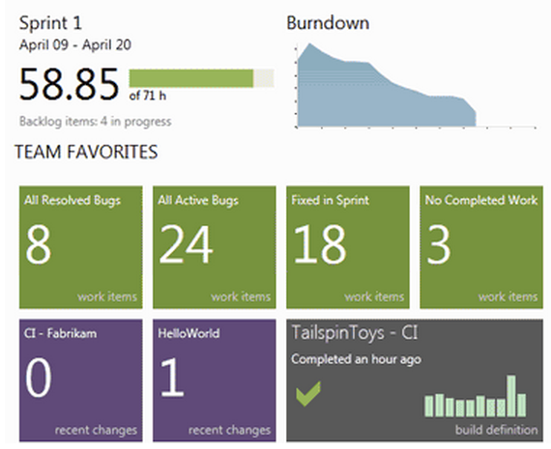
How do I manage my team?
Build Management & Automation
Version Control
Agile Project Planning
http://tfs.visualstudio.com/en-us/feature-tour.aspx#Section2
Notes:
Slide Objectives
VALUE PROP
TFS can be very valuable in mapping and tracking a project
Speaker Notes
Hours left, burn down
Track bugs and defects
If Probstfeld attends, ask him how valuable this was at HealthMarkets
Notes

Slide 83
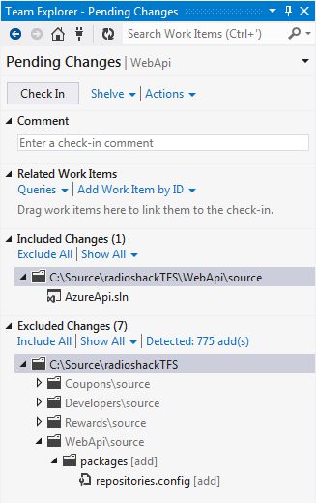
How do we handle source code?
Build Management & Automation
Version Control
Agile Project Planning
Notes:
Slide Objectives
VALUE PROP
TFS can be very valuable in version control.
Speaker Notes
Really easy to use interface
Code is checked in/checked out from the cloud
Changesets can be linked to work items and user stories
Notes

Slide 84
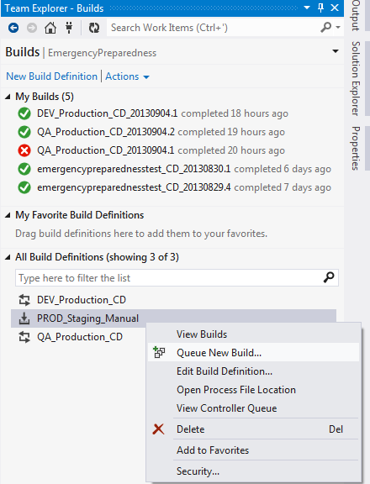
How do we build and deploy our code?
Build Management & Automation
Version Control
Agile Project Planning
Notes:
Slide Objectives
VALUE PROP
TFS can be very valuable in automatically building and deploying code
Speaker Notes
Builds can deploy to any cloud service or website in Azure
Builds can deploy to either Production or Staging slots
Can run with/without tests
Builds can be triggered in 5 different ways:
Manual
Continous Integration: each check-in queue another build
Rolling builds: let’s check-ins build up
Gated check-in: only code that doesn’t break the build is checked in
Scheduled
Notes

Slide 85
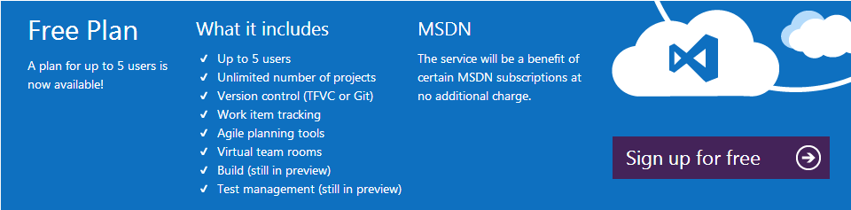
How much does it cost?

Slide 86
Distributed Computing

Slide 87
CAP Theorem
In theoretical computer science, the CAP theorem, also known as Brewer's theorem, states that it is impossible for a distributed computer system to simultaneously provide all three of the following guarantees:
Consistency (all nodes see the same data at the same time)
Availability (a guarantee that every request receives a response about whether it was successful or failed)
Partition tolerance (the system continues to operate despite arbitrary message loss or failure of part of the system)
According to the theorem, a distributed system cannot satisfy all three of these guarantees at the same time. In May 2012 Brewer clarified some of his positions on why the oft-used "two out of three" concept can be misleading or misapplied. Source: http://en.wikipedia.org/wiki/CAP_theorem

Slide 88
CAP Theorem: 12 Years Later
”CAP prohibits only a tiny part of the design space: perfect availability and consistency in the presence of partitions, which are rare.
…
The modern CAP goal should be to maximize combinations of consistency and availability that make sense for the specific application.”
Eric Brewer http://www.infoq.com/articles/cap-twelve-years-later-how-the-rules-have-changed

Slide 89
Multiple Fronts
Delivering software at non-trivial scale
Scaling across cores, devices, datacenters
Identify constraints
Scale Units
Power Requirements
Latency
Consistency
…. Many more

Slide 90
Consider Traditional Pitfalls
Understand the evils of mutable state
Learn the powers of immutability
Learn from the real world
The answer often lies in workflow

Slide 91
Questions

